Slide 1
Database Project Demo
By: Johnson Vu

Slide 2
Introduction
Video games like rpgs (role-playing games) encompass a virtual reality environment/economy that is fun in nature, but where does all the in-game content come from? How does it all exist for users to see?
A database must be set up to hold the in-game content as well as an interface that will interact with the database and display the necessary information for users.
In this project, a website made for the game will display the necessary information for users by interacting with the game’s database.

Slide 3
Scope
The project would serve users of a popular game (with a playerbase of millions)
Because the database can only hold one game’s data, it would work for that one game.

Slide 4
Pre-Demo
Item Page
Login
User Account/Purchase History
Signup

Slide 5
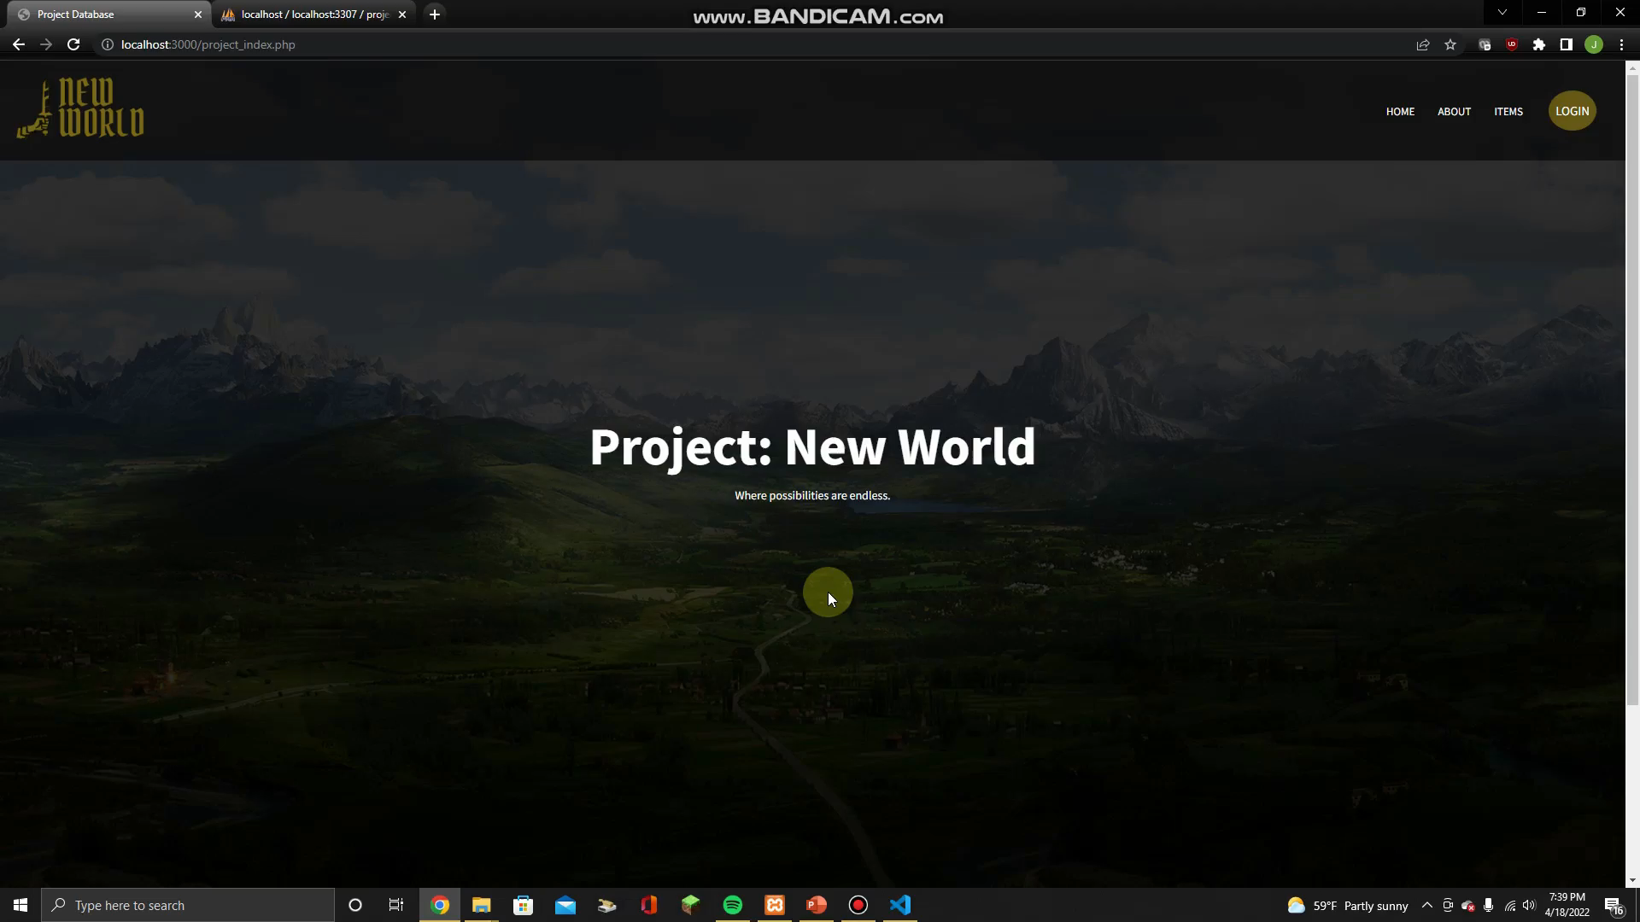

Slide 6
Video Link
If needed
https://youtu.be/yjW5QKueLxE

